Slide 1
ONIS: Guideline-directed Medical Therapy Treatment Pattern Among Adults with Chronic Kidney Disease in China: a national wide cross-sectional study
ONIS study concept
for PEC Endorsement
Wenjing Tan, Chloe Wang
ECR: external collaborative research.
Notes:
缩写
1. 总费用

Slide 2

Executive Summary
SGLT2i significantly reduce cardiovascular and renal events in CKD patients, leading to their inclusion as first-line therapy in both global (KDIGO 2024) and Chinese (2023/2025) guidelines.
EASi-KIDNEY trial is under-development, will be approved in Jan 2029
The vision of vica-empa is to replace SGLT2i/SGLTi and ns-MRA becoming 1st line foundational therapy for CKD management
Background
Key Message/Rationale
Understanding treatment opportunity gaps and barriers will be necessary for GDMT implementation
Introducing the concept of GDMT can help lay the groundwork for effective medical education in preparation for the vica-empa launch
Study type/Data source
A non-interventional, cross-sectional study utilizing existing data from the China Kidney Disease Network (CK-NET).
Request for CEC
Seek for PEC's endorsement
CDC: Center for disease control and prevention ; EHR: electronic health records
Notes:
Launch做准备

Slide 3
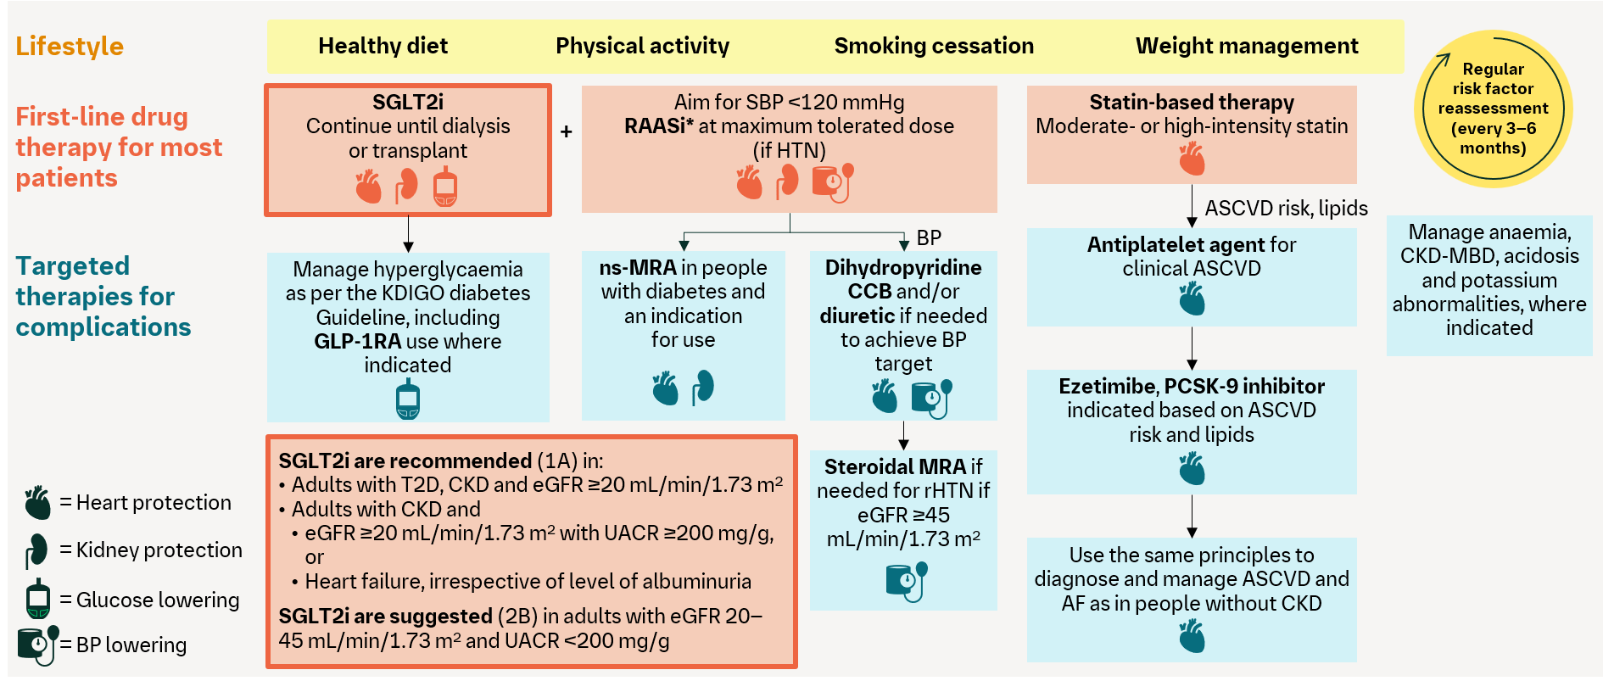
Study background
The cardiovascular and kidney benefits of SGLT2 inhibitors in patients with chronic kidney disease (CKD) are well established in large pivotal trials. This has prompted updates to SGLT2 inhibitor drug licences and the publication/update of clinical guidelines relating to their use, including ‘Kidney Disease: Improving Global Outcomes’ (KDIGO) guidelines in 2024 and ‘Guidelines for the early evaluation and management of chronic kidney disease in China’ in 2023.
However, the implementation of updated SGLT2 inhibitor guidelines and prescribing in the real-world CKD population remains largely unknown
Understanding treatment opportunity gaps, highlighting potential barriers and disparities are essential in guiding the successful GDMT.
Kidney Disease: Improving Global Outcomes (KDIGO). Kidney Int 2024;105:S117.

Slide 4
The Gap Between SGLT2i Guideline Recommendations and Real-World Practice in CKD Management Highlights the Urgent Need for Real-World Research
Established Cardiorenal Benefits of SGLT2i
Large clinical trials have demonstrated that SGLT2 inhibitors (SGLT2i) significantly reduce cardiovascular and renal events in CKD patients, leading to their inclusion as first-line therapy in both global (KDIGO 2024) and Chinese (2023/2025) guidelines.
Discrepancy Between Guidelines and Clinical Practice
Despite strong recommendations, the real-world prescription rate, treatment patterns, and influencing factors for SGLT2i use among CKD patients in China remain unclear. There is a lack of systematic, nationwide data, which hinders effective guideline implementation and maximization of patient benefit.
Rationale for the Study
There is an urgent need for real-world studies to systematically assess SGLT2i use, guideline adherence, and barriers in CKD management in China.
Understanding treatment opportunity gaps, highlighting potential barriers and disparities are essential in guiding the successful GDMT, optimize CKD management strategies and improve patient outcomes.

Slide 5
Study Objective
Primary objective
1
To quantify rates of individual & combination treatment in prevalent CKD
  To estimate the proportion of guideline-directed medical therapy (GDMT) of SGLT2i in patient with guideline-eligible CKD patients in 2024 and 2025 in China
Follow global LEXIC study research objective
Secondary objectives
2
To describe the demographics and clinical characteristics of CKD patient in China
Exploratory objective
3
To identify factors associated with prescribing SGLT2i as part of GDMT vs non-GDMT in China
HCRU: Healthcare resource utilization

Slide 6



Data Source: China Kidney Disease Network
~ 22
Lead by 赵明辉&张路霞教授，北京大学第一医院
Hospitals
Institutions
EHR
Demographics, Diagnoses, Prescriptions, Lab tests, Surgeries, Imaging text reports
Data
Cross-sectional
Patient diagnosed with CKD who visited between Jan 1 2023 – Dec 31, 2025
Design
1. 北京市卫健委《2023年北京卫生健康事业发展统计公报》

Slide 7
Study Design:
Cross-sectional study
Index date: the last relevant prescription of inpatient group or at least two same prescriptions of outpatient group
Inclusion criteria:
Adult CKD patients
Exclusion criteria:
T1D, polycystic kidney disease,
history of kidney transplantation;
Aug. 2023
Chinese guideline
2026
Nov. 2023
Jardiance approval for CKD
Patient identification:
Jan 1st, 2024 - Dec 31th, 2025
Notes:
2023

Slide 8
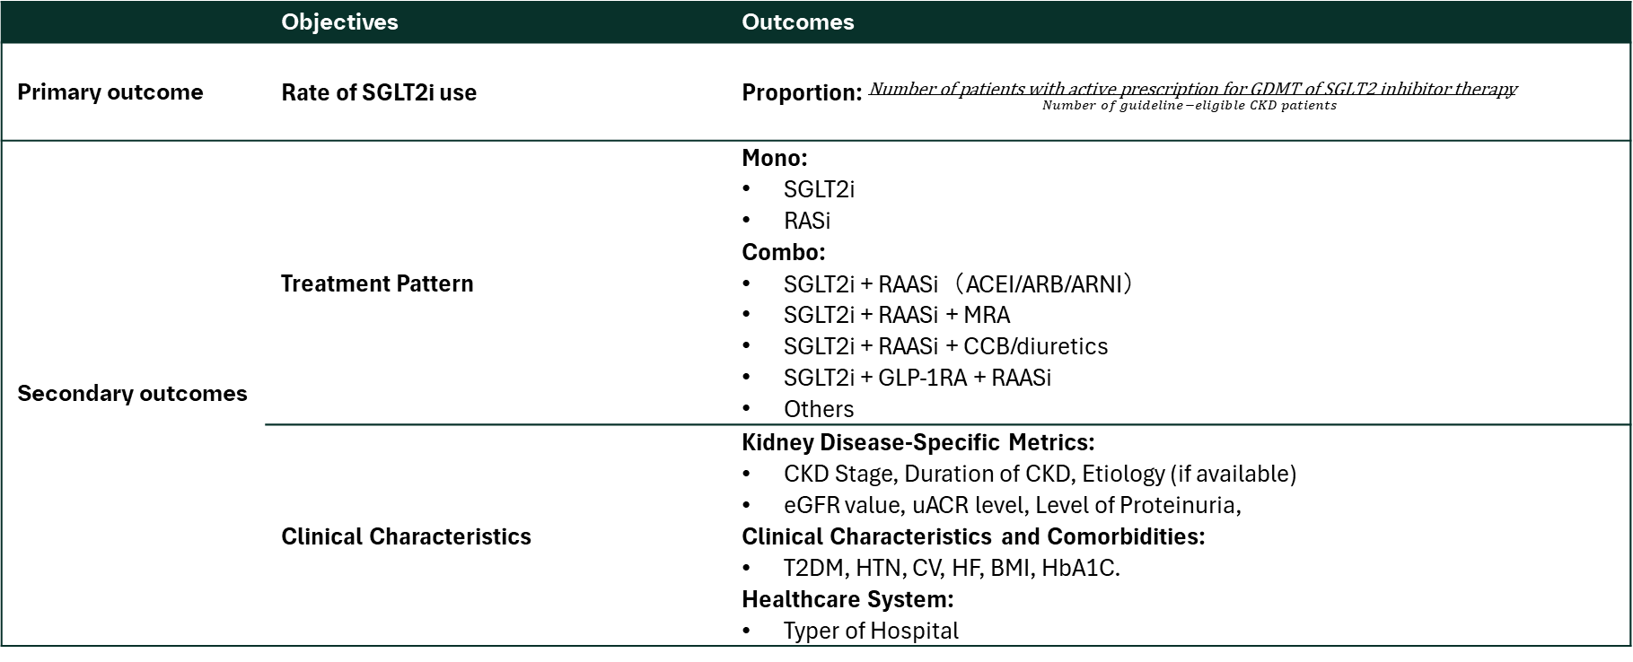
Study Outcomes
 | Objectives | Outcomes
Primary outcome | Rate of SGLT2i use | Proportion: $\frac{\text{N}\text{umber} \text{of} \text{patients} \text{with} \text{active} \text{prescription} \text{for} \text{GDMT} \text{of} \text{SGLT}\text{2 }\text{inhibitor} \text{therapy}}{Number of guideline−eligible CKD patients }$
Secondary outcomes | Treatment Pattern | Mono: SGLT2i RASi Combo: SGLT2i + RAASi（ACEI/ARB/ARNI） SGLT2i + RAASi + MRA SGLT2i + RAASi + CCB/diuretics SGLT2i + GLP-1RA + RAASi Others
 | Clinical Characteristics | Kidney Disease-Specific Metrics: CKD Stage, Duration of CKD, Etiology (if available) eGFR value, uACR level, Level of Proteinuria, Clinical Characteristics and Comorbidities: T2DM, HTN, CV, HF, BMI, HbA1C. Healthcare System: Typer of Hospital
GLP-1RA
sMRAs
Statins
Finerenone
按分层因素(T2D, obesity, HTN, eCVD, GN, and KDIGO stages)进行治疗模式描述
Notes:
总部trt
Exploratory-time-to-event () SGLT2i, MET, DPP-4i, GLP-1 RA, Insulin; ACEI, ARB, β-blocker, CCB; Statins; Aspirin; Anticoagulants, etc.

Slide 9

Statistical Analysis Methods
Primary outcomes:
Proportion ：
Secondary outcomes:
Treatment pattern:
Clinical characteristics:
Exploratory outcome:
Risk factors
Describe proportion of GDMT with SGLT2 Inhibitors among the guideline-eligible CKD patients
95% CI for prevalence estimates
In 2024, 2025
Subgroup analysis (T2DM, obesity, HTN, eCVD, GN, and KDIGO stages)
Descriptive analysis
Describe treatment pattern of CKD patients by Mono/Combo
In 2024, 2025
Subgroup analysis (T2D, obesity, HTN, eCVD, GN, and KDIGO stages)
Descriptive analysis
Mean ± SD or Median [IQR]) for continuous variables
Number (percentage) for categorical variables
Multivariable logistic regression to explore the association between risk factors and SGLT2 inhibitor prescription
Odds ratios with 95% confidence intervals for each characteristics such as eGFR, comorbidities, etc.

Slide 10
Estimated key study milestone and budget
Start to provide RWE
RWS: CKD GDMT
2025 |  |  | 2026 |  |  |  | 2027 |  |  |  | 2028 |  |  |  | 2029 |  |  |  | 2030
Oct | Nov | Dec | Q1 | Q2 | Q3 | Q4 | Q1 | Q2 | Q3 | Q4 | Q1 | Q2 | Q3 | Q4 | Q1 | Q2 | Q3 | Q4 | Q1 | Q2 | Q3 | Q4
Dec.25
CEC&PEC endorse
Apr.26
Corporate endorse
Jul.26
CTP app
Dec.26
Contract
sign-off
2027Q2
Final
analysis
2027Q4
CTR
2028Q2
WCN/ERA-EDTA Congress
Dec.28
Manuscript
Ph-III: EASi-KIDNEY
Dec.28
CTR
Jan.29
CHN app.
(best case)
Sep.25
FSS
Total budget: 2,000,000 RMB, global funding
Notes:
publication
这里开始持续产生insights for internal use
三期提前1年

Slide 11


Collaboration
Epidemiological PI:
北医三院 曾琳
硕士生导师、流行病学家
Clinical PI:
北京大学第一医院 张路霞
肾内科主任医师
Notes:
With yin
大型队列的leading PI，赵明辉

Slide 12
Summary of Study Impact
Understanding treatment opportunity and gaps, introducing the concept of GDMT
Support the vision of vica-empa is to replace SGLT2i/SGLTi and ns-MRA becoming 1st line foundational therapy for CKD management
Collaborate with China Kidney Disease Network
To gain evidence-based insights and strengthen our scientific leadership in CKD
Notes:
巩固治疗理念，支持vision foundation therapy，scientific leadership

Slide 13
ECR: Prevalence, treatment pattern and outcome of patients with hypertension, type 2 diabetes and established cardiovascular disease (without heart failure) in China
ECR study concept
for PEC Endorsement
Wenjing Tan, Chloe Wang
ECR: external collaborative research.
Notes:
CVRR??

Slide 14
Executive Summary
Background
The number of patients in China with coexisting T2DM, HTN, and established CVD is substantial and continues to grow. These patients are at extremely high risk of developing heart failure (HF). ​ EASi™-PROTKT phase III trial is on going. Expected to have results by Apr 2030.
Key Message/Rationale
Leveraging RWD to provide up-to date local evidence on patient number, treatment landscape and relevant clinical outcomes will help to:
Support HF Tier 1 prevention strategy and provide reference data for endpoint estimation.
Guide medical strategy, HCP education, and future guidelines.
Study type/Data source
An ECR with CDC(consulting on clinical experts)
A retrospective observational study based on four data sources including 1) Beijing Claims data, 2) Summary of Inpatient Discharge (病案首页), 3) 死因监测数据 and 4) CCDRFS(慢性病危险监测数据) .
Request for CEC
Seek for PEC’s endorsement
CDC: Center for disease control and prevention ; EHR: electronic health records
Notes:
CVRR定义
为三期临床研究提供真实世界数据支持，一级预防

Slide 15
Call for Large-scale Real-World Data to Reveal the Treatment Landscape of High-Risk Multimorbidity Populations in China
The number of patients in China with coexisting type 2 diabetes (T2DM), hypertension (HTN), and established cardiovascular disease (eCVD) is large and continues to grow. These patients are at extremely high risk of developing heart failure (HF).
  Limited and unsystematic real-world data
    Disease burden
    Treatment landscape
      Patient adherence, combination therapy patterns, and true impact on heart failure prevention
      Clinical situation may be complex due to diverse patient factors, physician preferences, and regional disparities.
      Further understanding is needed regarding the implementation of emerging therapies (e.g., SGLT2i) in practice
  Unique Value of Real-World Data
  Real-world studies (RWS) can leverage multiple data sources (e.g., CDC surveillance, EHR, insurance claims) to systematically reveal prevalence, treatment patterns and outcomes.
  RWD provides localized baseline data and clinical practice context for phase III studies, supporting a comprehensive understanding of the value of innovative therapies in real-world settings.
    Existing literature and guidelines highlight the need for further studies on real-world management and outcomes in this population.

Slide 16
RWS Provides Critical Complement to Phase III Trials, Supporting Optimized Future Chronic Disease Management in China
Closing data gap through revealing the treatment landscape of high-risk multimorbidity populations in China
Complement RCT evidence, enhancing external validity and supporting localized interpretation of results
  RWS provide local data on patient characteristics, medication use, adherence, and outcomes, supporting interpretation and application of EASi™-PROTKT phase III results in China.
Inform clinical and policy decisions:
  Systematic evaluation of prevalence, treatment patterns and outcomes helps identify practice gaps and supports guideline updates and policy making.
  RWS evidence supports innovation in chronic disease management, tiered care, and multidisciplinary collaboration, as emphasized by both domestic and international guidelines.
Close Data Gap
Identify practice gap
RWE
Practice Optimization
Guideline Updates
Chronic Disease Management Innovation

Slide 17
Objectives
Primary objectives
To evaluate clinical outcomes (including CV death, HHF or urgent HF visit) among patients in China with HTN, T2D and established CVD (without HF)
Secondary objectives
To characterize treatment patterns among patients with HTN, T2D and established CVD (without HF) in China
To estimate the prevalence of patients with HTN, T2D and established CVD (without HF) in China
HTN: hypertension, T2D: type 2 diabetes, CVD: cardiovascular disease, HF: heart failure

Slide 18
Study Method： Data Source I
Collaborate with CDC to Leveraging Diverse Databases for Comprehensive Objectives and Reliable Outcomes
 | Data Source Requirements to Achieve Study Objectives | Recommend Database
Primary Objective | Clinical Outcomes Outcomes record: Death & HHF & urgent HF visit Longitudinal with sufficient follow-up period | 北京医保数据 (linked with死因监测数据)
Secondary Objective | Treatment pattern Prescription record Prevalence Diagnosis record
Limitation :
Lack national representativeness
Beijing Claims Database (北京医保数据)
NDSS (死因监测数据)
Beijing residence claims data
Longitudinal data-cohort starting from 2019/01/01
Including demographics, diagnosis (urgent HF visit)) and treatment
National representativeness​
Include death record and cause of death;
Record linked with the public security administrative system
Updated every year
Notes:
CDC合作，希望能和更多临床专家合作；CDC合作，唯一能够提供多个数据，唯一open给企业的数据库；

Slide 19
Study Method： Data Source II
Collaborate with CDC to Leveraging Diverse Databases for Comprehensive objectives and Reliable Outcomes
 | Data Source Requirements to Achieve Study Objectives | Recommend Database
Secondary objectives | Prevalence Cross-sectional Representativeness Diagnosis record | 慢性病危险监测数据+病案首页
CCDRFS
(慢性病危险监测数据)
Summary of Inpatient Discharge
(病案首页）
National representativeness​ population-based survey
Focus on chronic disease incl. hypertension, diabetes, dyslipidemia, stroke, MI
Include disease risk factors, diagnosis
Year 2010, 2013, 2015, 2018, 2023
National-level, Tier2 and 3 hospitals
Inpatient discharge summary, incl. age, gender, diagnosis and outcome (incl. HHF）
Longitudinal data-cohort linked patient each visit
Start from 2020
Notes:
删除原因：慢危没有HF

Slide 20
Study Design and Outcomes
Primary Objectives
 | Study design | Outcomes
Clinical outcomes | Cohort | Incidence & Occurrences: Incidence of CV death, HHF or urgent HF visit Incidence of CV death or HHF Incidence of CV death, HHF, non-fatal MI or non-fatal stroke Occurrences of all-cause hospitalizations
Index date: the earliest date diagnose as HTN, T2D and established CVD (w/o HF)
Dec 31th, 2027
Inclusion Criteria:
Adults, diagnosis of with HTN, T2D and established CVD (without HF)
Follow-up
Cohort identification period:
Jan 1st , 2019 - Dec 31th, 2024
HHF: hospitalisation for heart failure; EHR: electronic health records;
Notes:
文献，HTN/T2D
Index_date
Exploratory-time-to-event () SGLT2i, MET, DPP-4i, GLP-1 RA, Insulin; ACEI, ARB, β-blocker, CCB; Statins; Aspirin; Anticoagulants, etc.

Slide 21
Exploratory endpoint
For SGLT2i users/ GLP1 RA users :
 | Study design | Outcomes
Clinical outcomes | Cohort | Time to events & Occurrences: Time to event of CV death, HHF or urgent HF visit Time to event of CV death or HHF Time to event of CV death, HHF, non-fatal MI or non-fatal stroke Occurrences of all-cause hospitalizations
Inclusion Criteria:
diagnosis of with HTN, T2D and established CVD (without HF)
Index date: the first prescription of SGLT2i & GLP1 RA
1-year wash-out
Follow-up
Dec 31th, 2027
Cohort patient identification period:
Jan 1st 2020- Dec 31th, 2026
HHF: hospitalisation for heart failure; EHR: electronic health records;
*Drug list include….
Notes:
文献，HTN/T2D
Exploratory-time-to-event () SGLT2i, MET, DPP-4i, GLP-1 RA, Insulin; ACEI, ARB, β-blocker, CCB; Statins; Aspirin; Anticoagulants, etc.

Slide 22



Study Design and Outcomes
Secondary Objectives
 | Study Design | Outcomes
Treatment pattern | Cross-sectional | Drug prescription: By Category: Anti-diabetic(e.g. SGLT2i,DPP-4i, GLP-1 RA, insulin) Anti-hypertensive (e.g., ACEi, ARB,MRA） Lipid-lowering (e.g., Statins, Ezetimibe) Combination
 | Cohort (SGLT2i & GLP1 group) | Drug Persistence: persistent without 60-day gap in therapy Drug Discontinuation: time to discontinuation (The last day of supply before gap) Drug Adherence: the proportion of days covered for one year Drug Switch: a change between SLGT2i or GLP1 products from one claim to the next for one year
  Antiplatelet (e.g., Aspirin）
  Others for CV protective(e.g., Aliskiren)
  Comorbidity management (e.g., Anticoagulants)
Index date: the last relevant prescription of inpatient group or at least two same prescriptions of outpatient group
Cross-sectional patient identification period:
Jan 1st 2026- Dec 31th, 2027
Inclusion Criteria:
diagnosis of with HTN, T2D and established CVD (without HF)
1-year wash-out
Follow-up
Cohort patient identification period:
Jan 1st 2020- Dec 31th, 2026
Index date: the first prescription of SGLT2i & GLP1 RA
HHF: hospitalisation for heart failure; EHR: electronic health records;
Notes:
文献，HTN/T2DThe last day of supply before gap
Exploratory-time-to-event () SGLT2i, MET, DPP-4i, GLP-1 RA, Insulin; ACEI, ARB, β-blocker, CCB; Statins; Aspirin; Anticoagulants, etc.

Slide 23
Study Design and Outcomes
Secondary Objectives
 | Study Design | Outcomes
Prevalence | Cross-sectional 2020-2027 (each year) | Prevalence: $\frac{\text{N}\text{umber} \text{of} \text{patients} \text{with} \text{HTN}\text{, }\text{T}\text{2}\text{D} \text{and} \text{established} \text{CVD}\text{ (}\text{without} \text{HF}\text{)}}{General population}$

Slide 24
Statistical Analysis Methods
Primary outcomes:
Clinical outcome：
Secondary outcomes:
Treatment pattern:
Demographics characteristics:
Prevalence：
Exploratory analysis:
The incident rate of each outcome event
Incidence rate=1000*Number of patients with the incident event/total number of person-years at risk
Subgroup analysis (SGLT2i/GLP-1RA)
Descriptive analysis
Describe treatment pattern by category/Combo, Persistent w/o 60 day gap, adherence and number of switches
Survival analysis
Time to drug discontinuation within one year
Descriptive analysis
Mean ± SD or Median [IQR]) for continuous variables,Number (percentage) for categorical variables
Describe prevalence of interested patients among the total number of inpatients
95% CI for prevalence estimates
Subgroup analysis (SGLT2i/GLP-1RA)
Leverage 病案首页 database to explore the clinical outcomes, including CV death, HHF, non-fatal MI or non-fatal stroke and Occurrences of all-cause hospitalizations

Slide 25
Estimated key study milestone and budget
Start to provide RWE
CVRR RWS
2025 |  |  | 2026 |  |  |  | 2027 |  |  |  | 2028 |  |  |  | 2029 |  |  |  | 2030
Oct | Nov | Dec | Q1 | Q2 | Q3 | Q4 | Q1 | Q2 | Q3 | Q4 | Q1 | Q2 | Q3 | Q4 | Q1 | Q2 | Q3 | Q4 | Q1 | Q2 | Q3 | Q4
Dec.25
CEC&PEC endorse
Apr.26
Corporate endorse
Jul.26
CTP app
Dec.26
Contract
sign-off
Dec.28
Final
analysis
Mar.29
CTR
Aug.29
ESC congress
Dec.29
Manuscript
Data collection and curation
Ph-III:1378-0041
Sep.25
FSS
Jan.30
DBL
Apr.31
CHN app
* Publication time
Total budget: 2,250,000 RMB
Notes:
这里开始持续产生insights for internal use

Slide 26
Collaboration
An ECR with CDC, consulting on clinical experts
Epidemiological PI:
Name | Department | Hospital
殷鹏 | 慢病中心 | 中国疾控中心
Clinical PI:
Name | Department | Hospital
杜昕 | 内科学（心血管病） | 北京安贞医院
Notes:
With yin

Slide 27
Clinical PI （nominate）
 | Name | Hospital | Academic Roles | Research Focus
First choice | Du Xin | Beijing Anzhen Hospital, Capital Medical University | Member, Clinical Research Management Group, Chinese Society of Cardiology (CSC); Director, Beijing George Institute for Global Health; Deputy Director, Beijing Cardiovascular Disease Prevention Office Editorial Board Member: Circulation, Journal of the American College of Cardiology, Chinese Journal of Cardiology | - Hypertension & small artery disease - Clinical trials on CVD prevention
Alternative1 | Liu Chen | The First Affiliated Hospital, Sun Yat-sen University | Deputy Chair, Youth Working Committee, Heart Failure Professional Committee, Chinese Medical Doctor Association Youth Member (10th), Cardiovascular Branch, Chinese Medical Association | - HF registry studies - High-risk population screening
Alternative2 | Ren Jingyi | China-Japan Friendship Hospital | Fellow, European Society of Cardiology (FESC) Member, Heart Failure Committee, Asian Heart Society (AHS) General, China Heart Failure Center Alliance | - Multicenter HF & hypertension trials - National R&D projects (14th FYP)
Alternative3 | Li Liwen | Guangdong Provincial People’s Hospital | Standing Committee Member, Heart Failure Professional Committee, Chinese Medical Doctor Association Vice Chair, Heart Failure Professional Physician Branch, Guangdong Medical Doctor Association | - HF & hypertension clinical trials - National R&D projects (13th & 14th FYP)

Slide 28
Summary of Study Impact
Quantify patient risk among HTN, T2D and established CVD (without HF) population
Support HF Tier 1 prevention and reference data for endpoint estimation.
Deliver insights on therapeutic approaches, adherence and switching behaviors
Guide medical strategy, HCP education, and future guidelines.
Estimate target population in China
Inform business strategy.

